Slide 1
Matthew 4:1-11 (NIV)
1Then Jesus was led by the Spirit into the desert to be tempted by the devil. 2 After fasting forty days and forty nights, he was hungry. 3 The tempter came to him and said, "If you are the Son of God, tell these stones to become bread." 4 Jesus answered, "It is written: 'Man does not live on bread alone, but on every word that comes from the mouth of God.' " 5 Then the devil took him to the holy city and had him stand on the highest point of the temple.

Slide 2
Matthew 4:1-11 (NIV)
6 "If you are the Son of God," he said, "throw yourself down. For it is written: " 'He will command his angels concerning you, and they will lift you up in their hands, so that you will not strike your foot against a stone.' " 7 Jesus answered him, "It is also written: 'Do not put the Lord your God to the test.' " 8 Again, the devil took him to a very high mountain and showed him all the kingdoms of the world and their splendor.

Slide 3
Matthew 4:1-11 (NIV)
9 "All this I will give you," he said, "if you will bow down and worship me." 10Jesus said to him, "Away from me, Satan! For it is written: 'Worship the Lord your God, and serve him only.' " 11Then the devil left him, and angels came and attended him.

Slide 4
Practices of Faith 2. Fighting Temptation - Greg Mellow
Notes:
4

Slide 5
Six weeks and Six practices
Keeping our relationship with God open (Confession)
Living a life of generosity (Giving)
Stopping sin before it takes hold (Fighting Temptation)
Work/life Balance
Growing deeper through Prayer
Walking with Jesus in our suffering (Trusting)
Notes:
5

Slide 6
Six Weeks and Six practices: Fighting Temptation
Fighting Temptation
temptation: the desire to do something, especially something wrong or unwise
Notes:
6

Slide 7
Six Weeks and Six practices: Fighting Temptation
Fighting Temptation
temptation: the desire to do something, especially something wrong or unwise
“Then Jesus was led out by the Spirit into the wilderness to be tempted by the devil. For forty days… he fasted… Then the devil came to him…”
Notes:
7

Slide 8
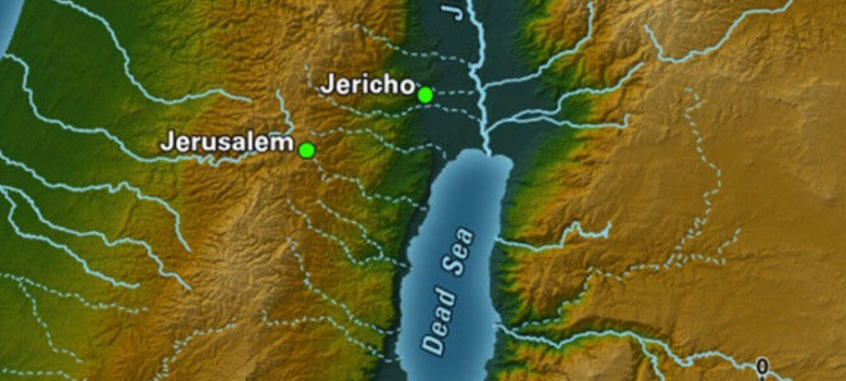
Judean Wilderness
Notes:
8

Slide 9
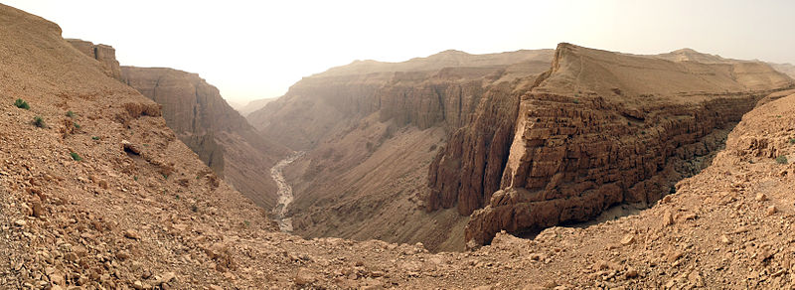
Judean Wilderness
Notes:
9

Slide 10
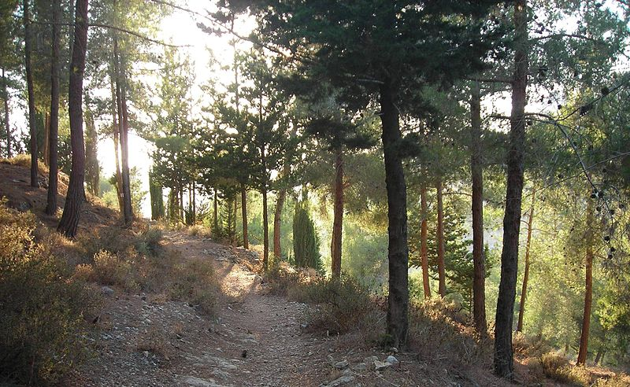
Judean Wilderness
Notes:
10

Slide 11
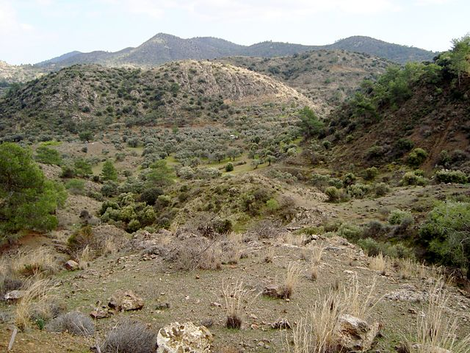
Judean Wilderness
Notes:
11

Slide 12
Six Weeks and Six practices: Fighting Temptation
Three temptations:
Turn stones into bread…
Do a flashy miracle…
Loyalty to God vs Power & Wealth
Notes:
12

Slide 13
Six Weeks and Six practices: Fighting Temptation
Three temptations:
Turn stones into bread…
Do a flashy miracle…
Loyalty to God vs Power & Wealth
In short: trade integrity & love,
for power and success?
Short term gain for long term pain.
Notes:
13

Slide 14
Six Weeks and Six practices: Fighting Temptation
Jesus’ response:
Reframing (by quoting a relevant Scripture)
focusing on a better goal.
Notes:
14

Slide 15
Six Weeks and Six practices: Fighting Temptation
Fighting Temptation – some suggestions
1. Reframing
focusing on a better goal.
Notes:
15

Slide 16
Six Weeks and Six practices: Fighting Temptation
Reframing: focusing on a better goal
Notes:
16

Slide 17
Six Weeks and Six practices: Fighting Temptation
Fighting Temptation – some suggestions
1. Reframing
focusing on a better goal.
2. Avoid the danger zones
Notes:
17

Slide 18
Six Weeks and Six practices: Fighting Temptation
2. Avoid the danger zones
Notes:
18

Slide 19
Six Weeks and Six practices: Fighting Temptation
Fighting Temptation – some suggestions
1. Reframing
focusing on a better goal.
2. Avoid the danger zones
plan … not there, not then
Notes:
19

Slide 20
Six Weeks and Six practices: Fighting Temptation
Fighting Temptation – some suggestions
1. Reframing
focusing on a better goal.
2. Avoid the danger zones
plan … not there, not then
change your circumstances, or routine
Notes:
20

Slide 21
Six Weeks and Six practices: Fighting Temptation
Fighting Temptation – some suggestions
Notes:
21

Slide 22
Six Weeks and Six practices: Fighting Temptation
Fighting Temptation – some suggestions
1. Reframing
focusing on a better goal.
2. Avoid the danger zones
plan … not there, not then
change your circumstances, or routine
3. Run, if necessary. Get help.
Notes:
22

Slide 23
Six Weeks and Six practices: Fighting Temptation
The Big Picture
“There are three kinds of people,
well poisoners, lawn mowers & life enhancers”
Walt Disney
Notes:
23

Slide 24
Six Weeks and Six practices: Fighting Temptation
The Big Picture
“There are three kinds of people,
well poisoners, lawn mowers & life enhancers”
Walt Disney
Notes:
24

Slide 25
Six Weeks and Six practices: Fighting Temptation
The Big Picture
“There are three kinds of people,
well poisoners, lawn mowers & life enhancers”
Walt Disney
Notes:
25

Slide 26
Six Weeks and Six practices: Fighting Temptation
The Big Picture
“There are three kinds of people,
well poisoners, lawn mowers & life enhancers”
Walt Disney
do not merely look out for your own personal interests, but also for the interests of others
Philippians 2:4
Notes:
26

Slide 27
Six Weeks and Six practices: Fighting Temptation
The Big Picture
“There are three kinds of people,
well poisoners, lawn mowers & life enhancers”
Walt Disney
“Let your light shine”
Jesus Christ
Let your good deeds shine out for all to see, so that everyone will praise your heavenly father
Notes:
27

Slide 28
Six Weeks and Six practices: Fighting Temptation
Fighting Temptation – some suggestions
1. Reframing
focusing on a better goal.
2. Avoid the danger zones
plan … not there, not then
change your circumstances, or routine
3. Run, if necessary. Get help.
4. Let your good deeds shine
Notes:
28

Slide 29
Six Weeks and Six practices: Fighting Temptation
“Then Jesus was led out by the Spirit into the wilderness … Then ... angels came and took care of Jesus.” Matthew 4:11
Notes:
29

Slide 30
Six Weeks and Six practices: Fighting Temptation
“God blesses those who patiently endure testing … they will receive the crown of life” James 1:12
Reframe, Avoid, Run, Shine
Receive life
Notes:
30

